Slide 1
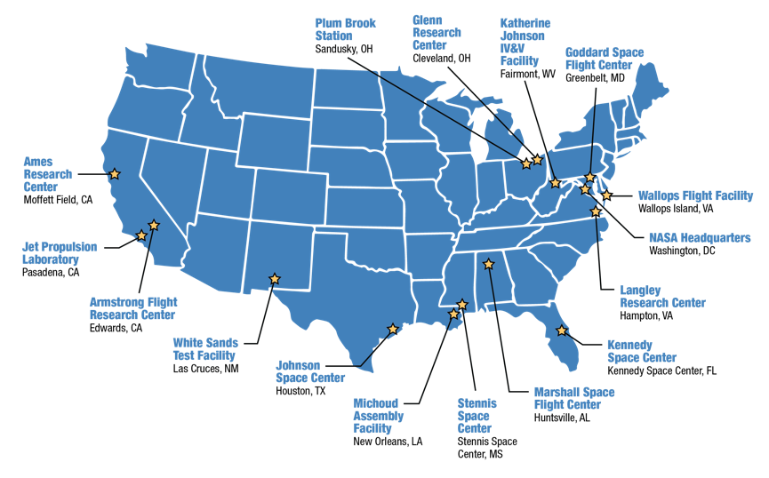
Every NASA Center Contributes to Artemis
Suppliers and small businesses across America have made contributions to the success of NASA’s Artemis program.
Private companies are hard at work on innovations that will help establish a sustainable human presence at the Moon. The Artemis endeavor also extends beyond our borders.
For detailed information about NASA’s partners and where to find them, visit the Artemis partners map at www.nasa.gov/content/artemis-partners

